Slide 1
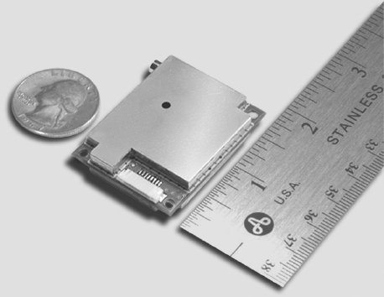
NomiGPS-TFS Time & Frequency Standard

Slide 2
NomiGPS-TFS
This is a checklist of the tasks required to get the Garmin GPS 15L-F unit provided by Naomi working as a GPS indicator device and 1 PPS frequency standard for a GPS disciplined oscillator and time standard.

Slide 3
Reference Documents
Garmin GPS 15L-F web
Garmin Technical Manual local web

Slide 4
Tasks – Make or Buy
GPS Antenna
Power Supply
Connector Cable.
Mounting Arrangement
10 MHz GPDO Converter
Control and visualization software.
Bill of Materials
Drawings

Slide 5
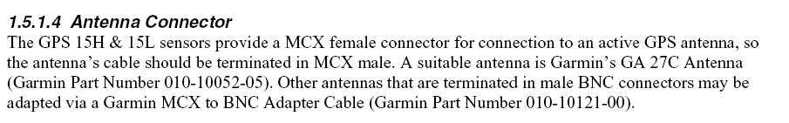

GPS Antenna

Slide 6

GPS Antenna

Slide 7
Power Supply
3.3 – 5.4 VDC with < 100 mV ripple
85 mA steady state
Garmin has onboard LDO
Use one 3.7 Varta lithium flat packs charged by TI charging chip.
Measure battery life off-unbilical.
Add parallel units to extend time.
Add series units and LM317 to increase voltage headroom.

Slide 8
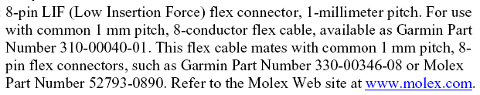
Connector Cable

Slide 9
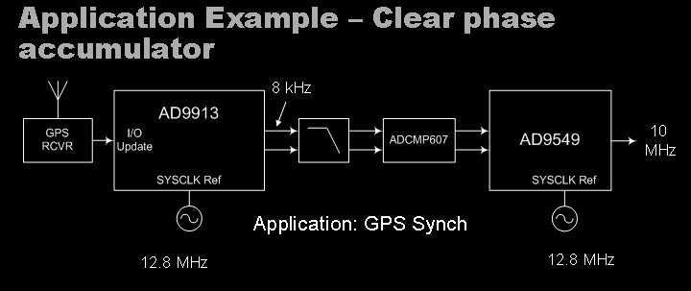
10 MHz GPDO Converter

Slide 10
Bill of Materials

