Slide 1
The Space Fence Antenna Design
L. Van Warren MS CS, AE
AE5CC

Slide 2
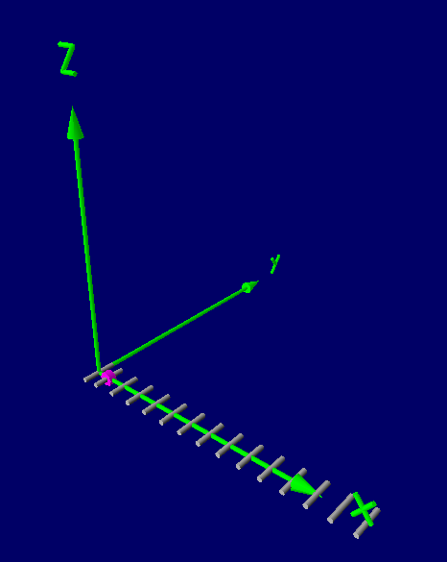
A High Gain Antenna for 217 MHz
Fan Shaped Pattern
Narrow Bandwidth
High Gain Along Fan

Slide 3
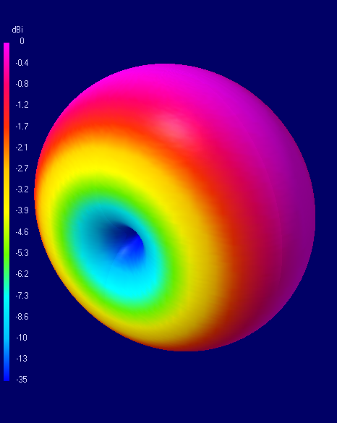
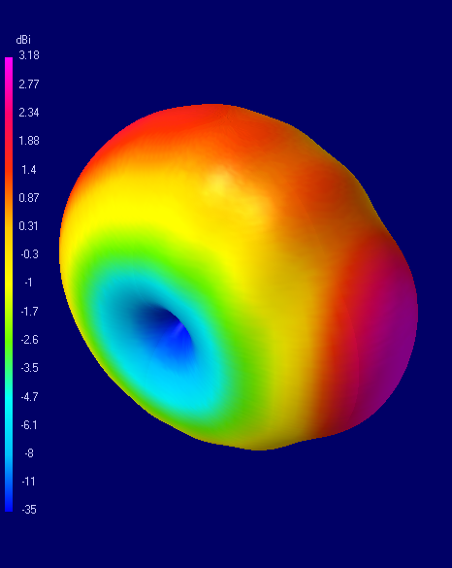
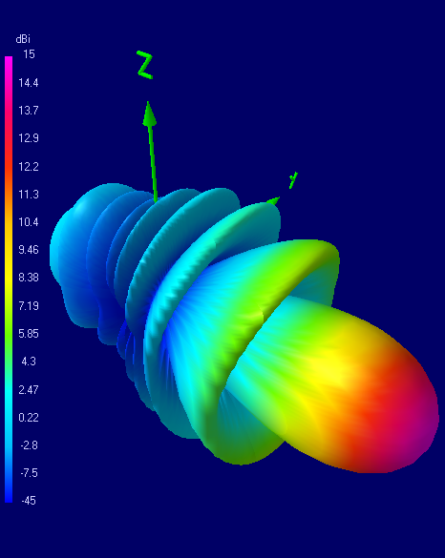
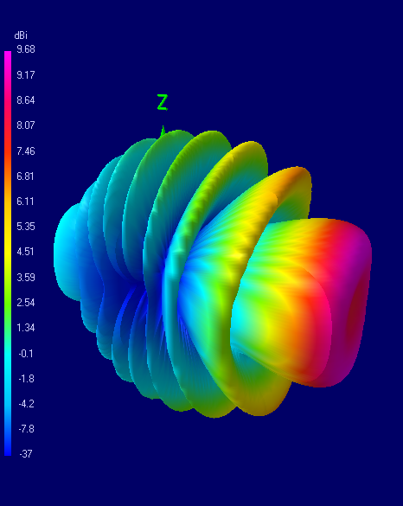
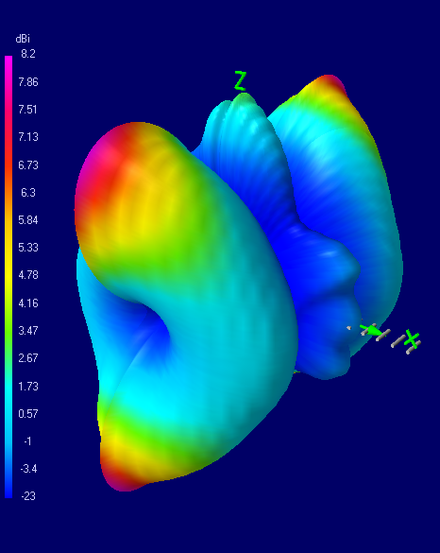
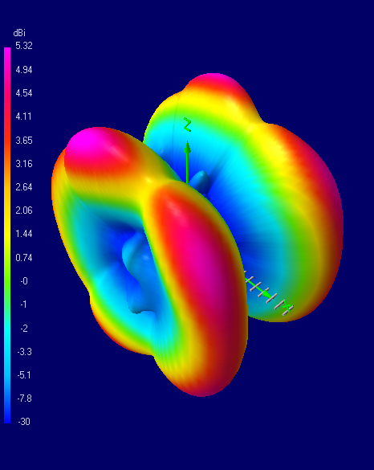
14 MHz
144 MHz
Best Gain
210 MHz
Best SWR
220 MHz
700 MHz
1000 MHz

Slide 4
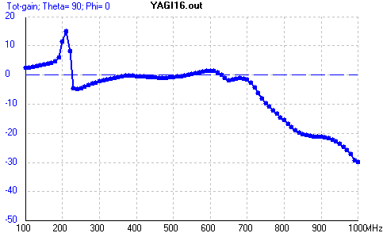
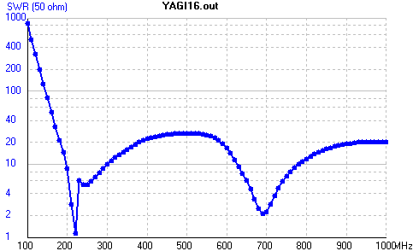
Yagi16 – Free Space 100 – 1000 MHz

Slide 5
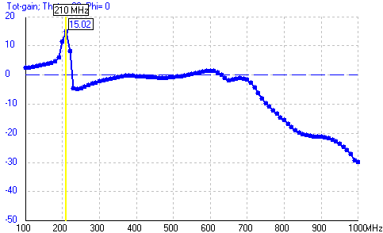
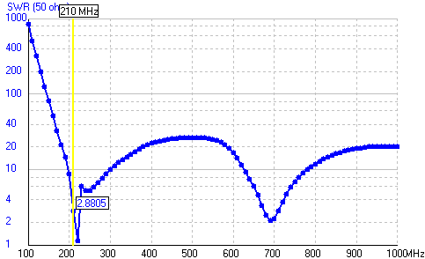
Yagi16 – Free Space 100 – 1000 MHz

Slide 6
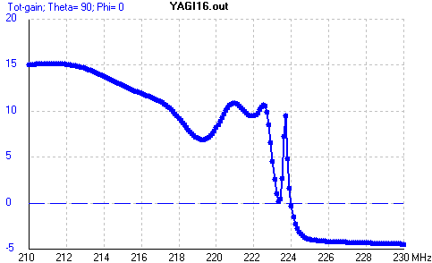
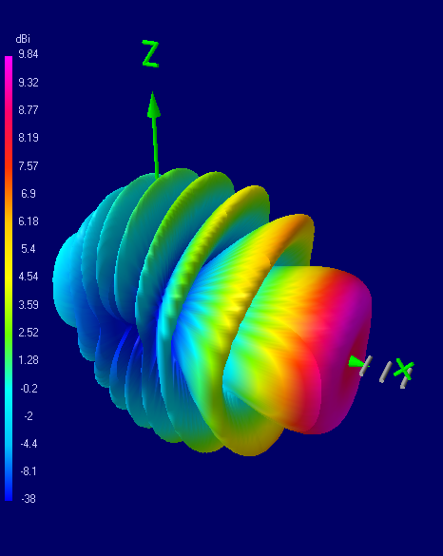
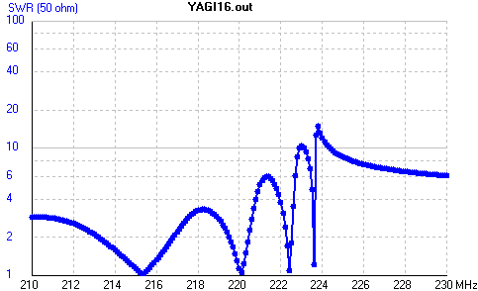
Yagi16 – Free Space 210 – 230 MHz

Slide 7
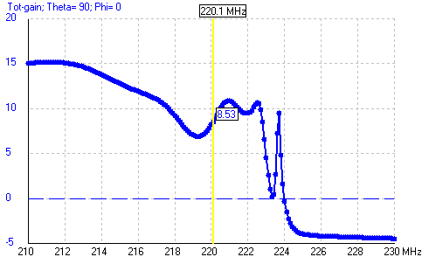
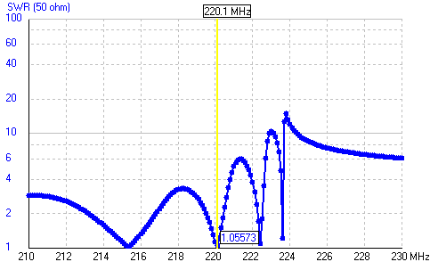
Yagi16 – Free Space 210 – 230 MHz

Slide 8
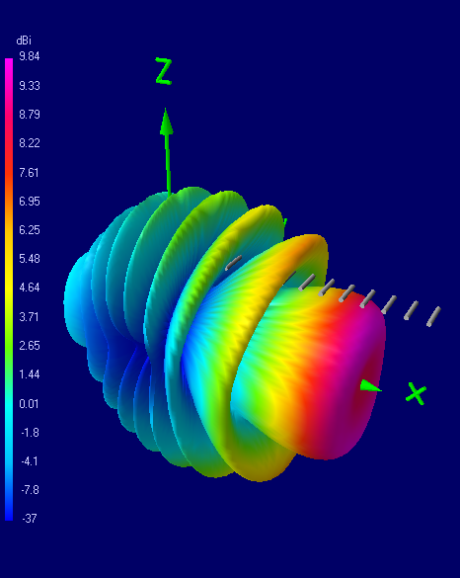
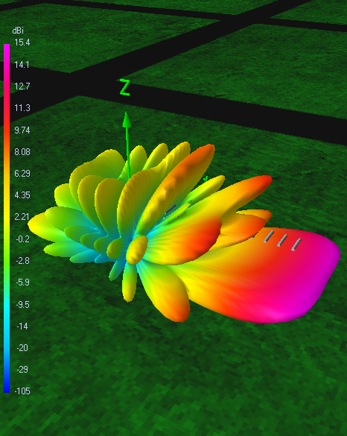
Yagi16 – Add Ground Plane
Free Space
6.6 feet
2 Meter Elevation

Slide 9
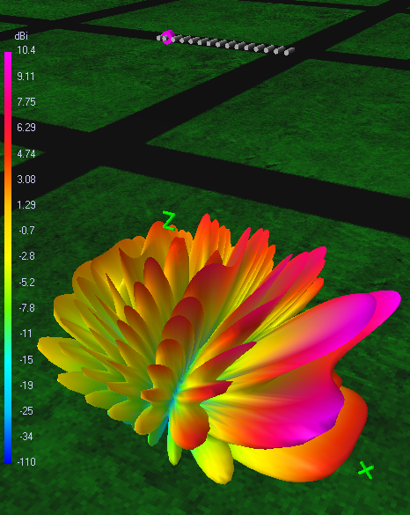
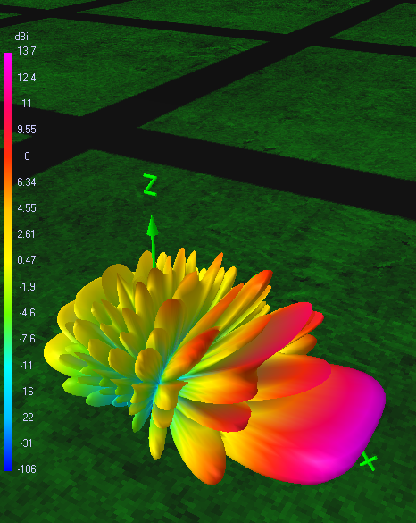
Yagi16 – Add Ground Plane
66 feet
20 Meter Elevation
Free Space
197 feet
60 Meter Elevation

Slide 10
A High Gain Antenna for 217 MHz
Lather
Rinse
Repeat

Slide 11
A High Gain Antenna for 217 MHz
Fan Shaped Pattern
Narrow Bandwidth
High Gain Along Fan

Slide 12
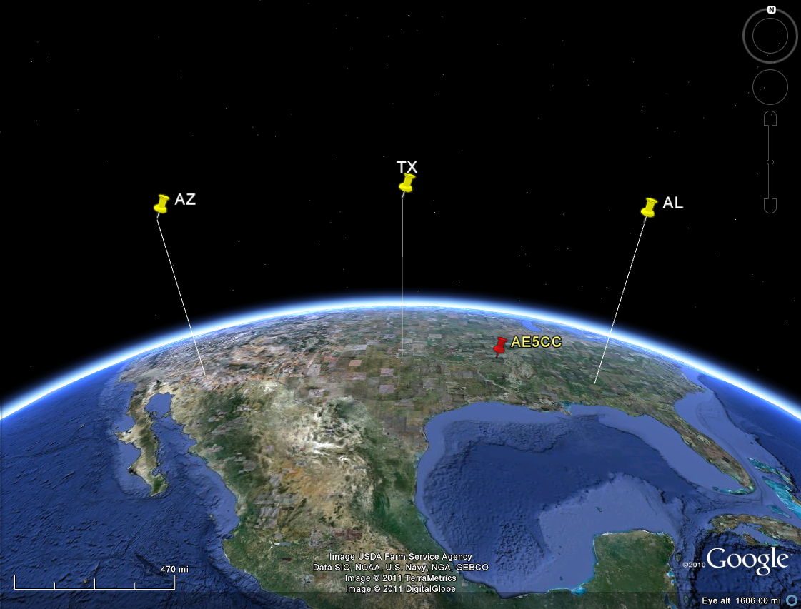
The Space Fence

Slide 13
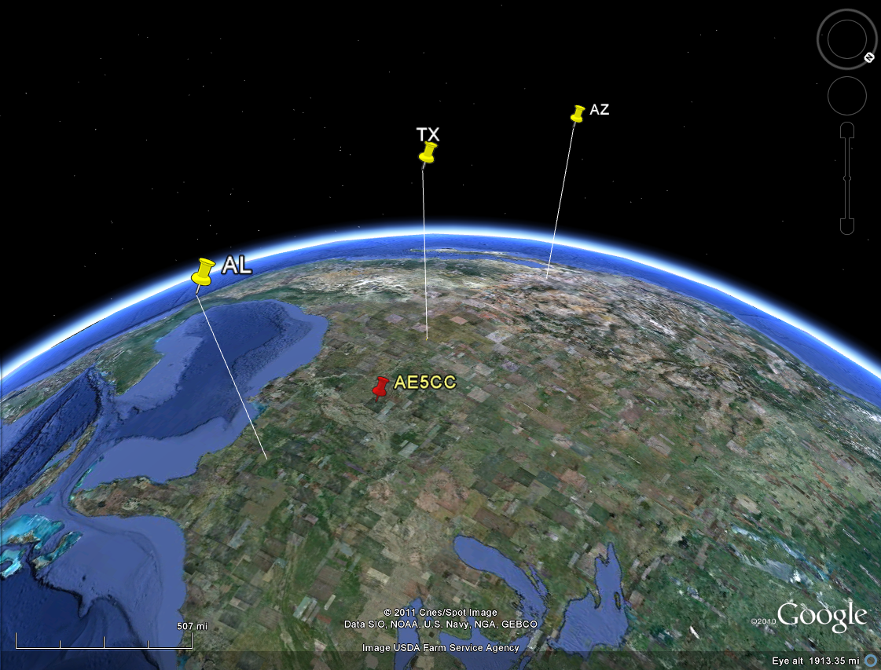
The Space Fence at 620 miles

Slide 14
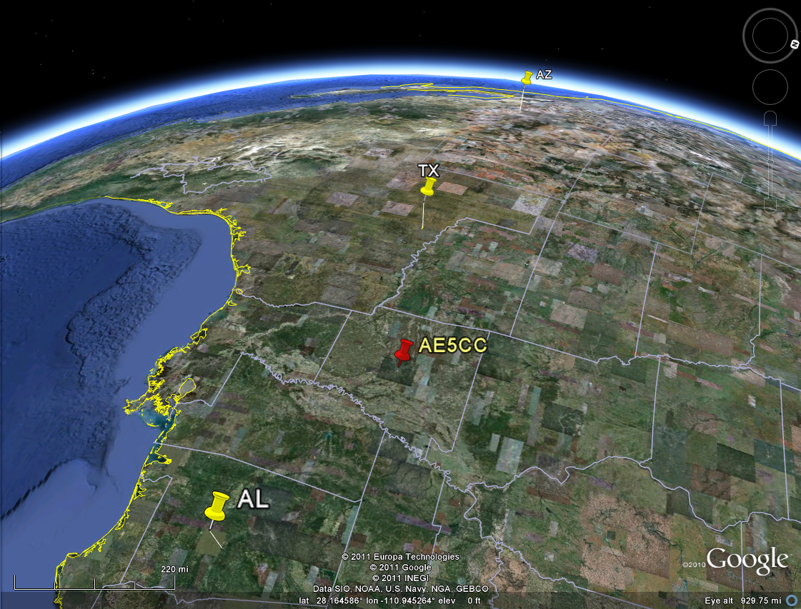
The Space Fence 60 mile altitude

Slide 15
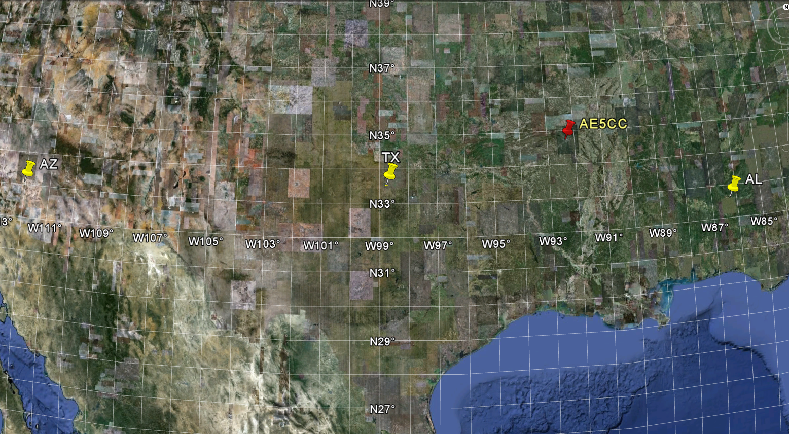
The Space Fence Near 33 parallel

Slide 16
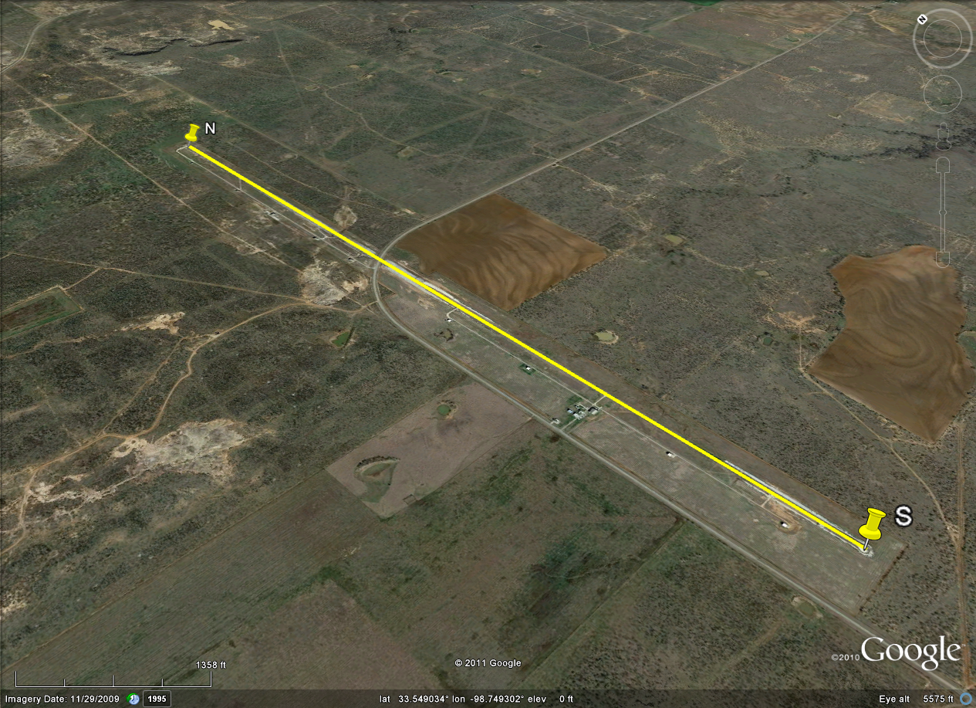
NAVSPASUR: Lake Kickapoo, TX
10, 664 feet

Slide 17
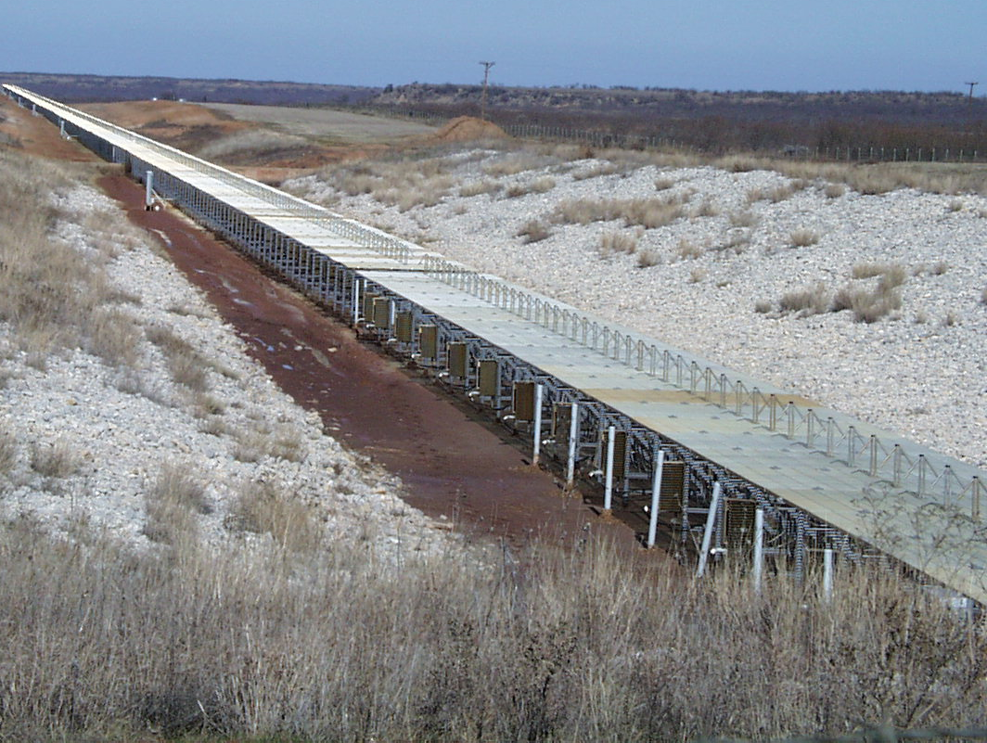
NAVSPASUR: Lake Kickapoo, TX

Slide 18
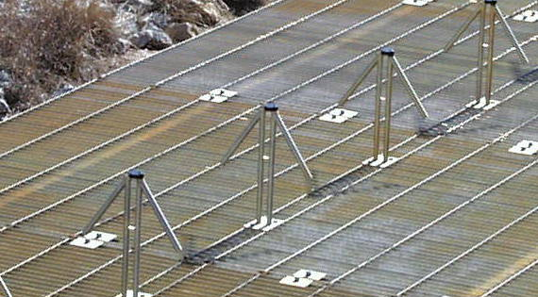
NAVSPASUR: Lake Kickapoo, TX
768,000 Watts ERP @ 216.983 MHz
10,664 feet long, in two sections, runs N/S.
2560 dipoles radiating 300 watts each
Most Powerful CW Station in the World

Slide 19
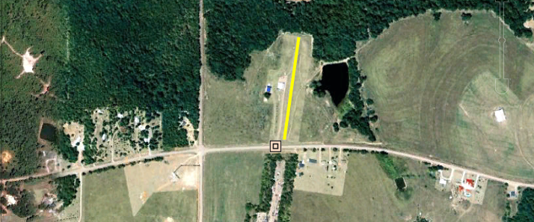
Jordan Lake, AL
38,400 Watts ERP @ 216.99 MHz
1032 feet long, oriented 8.21° E of due N.
256 dipoles radiating 150 Watts each
1/10th the length of TX site

Slide 20
Gila River, AZ
62,400 Watts ERP @ 216.97 MHz
1664 feet long, oriented 5.95° W of due N.
~416 dipoles radiating 150 Watts each
1/6th the length of TX site

Slide 21
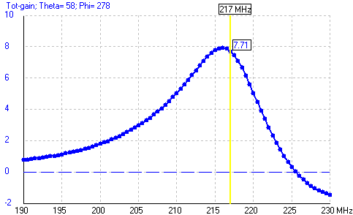
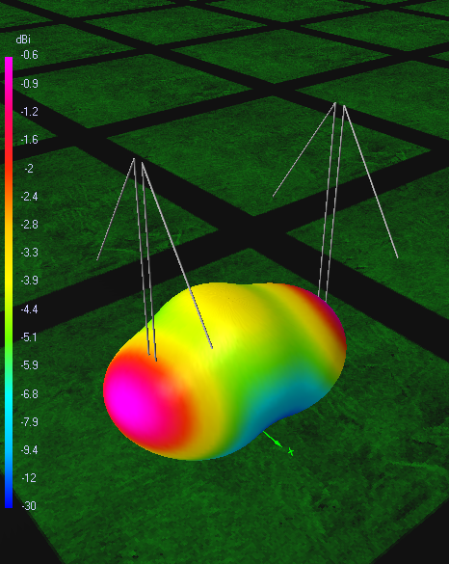
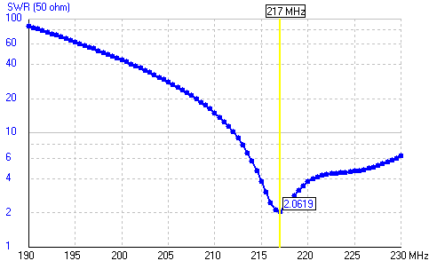
The Space Fence Element 217 MHz

Slide 22
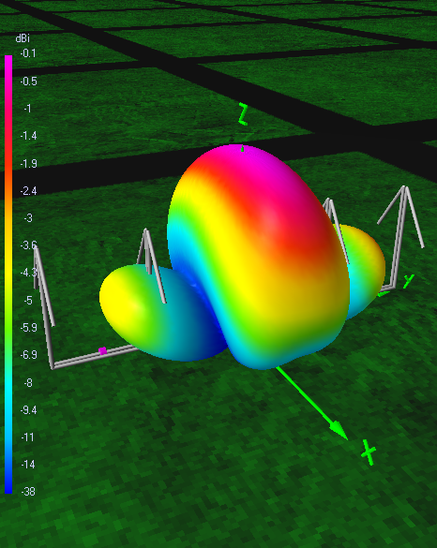
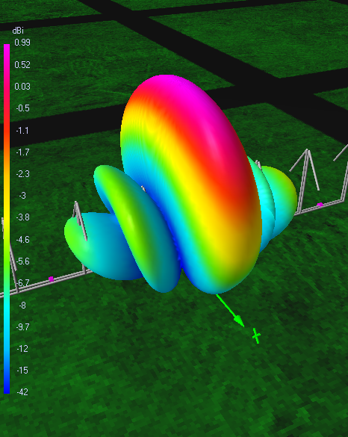
The Space Fence 217 MHz

Slide 23
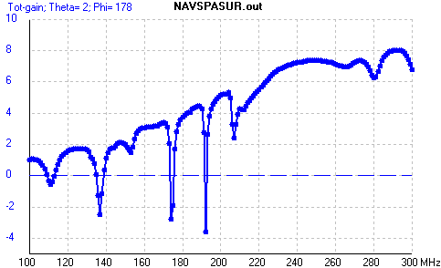
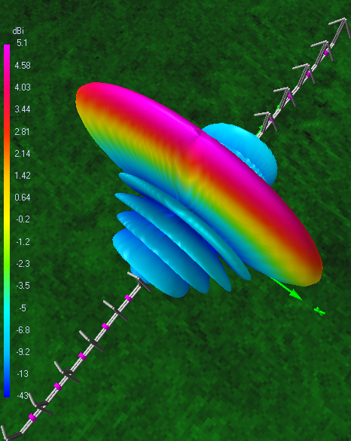
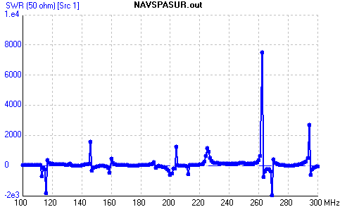
The Space Fence 217 MHz

Slide 24
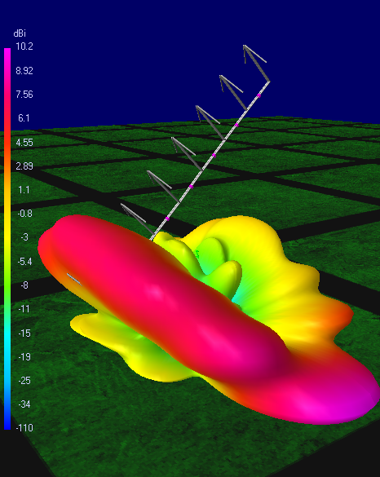
Fight Fire with Fire!
Fan Shaped Pattern
Narrow Bandwidth
High Gain Along Fan
12’ x 2’ x 1.5’ size
8 dipoles, 7 feeds
Angle 36° from vert.
60 mi
36°
83 mi

Slide 25
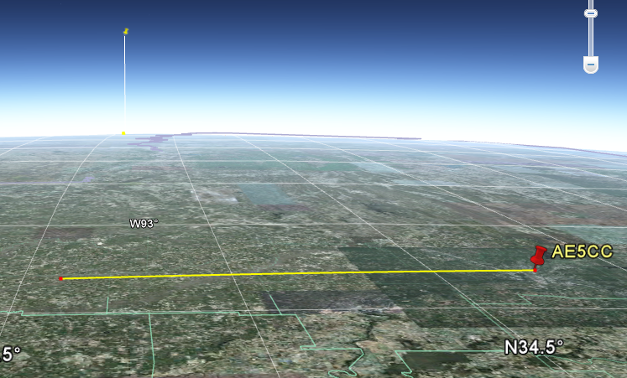
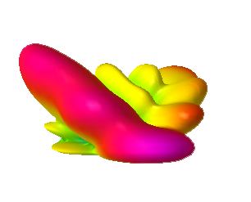
First Order Aim of 36°
60 mi
83 mi
36°

Slide 26
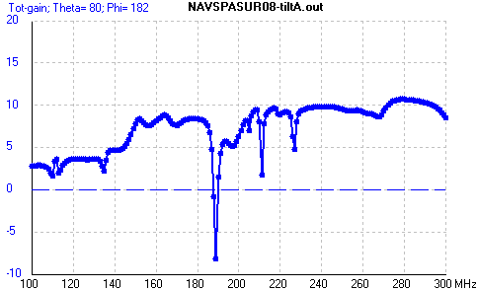
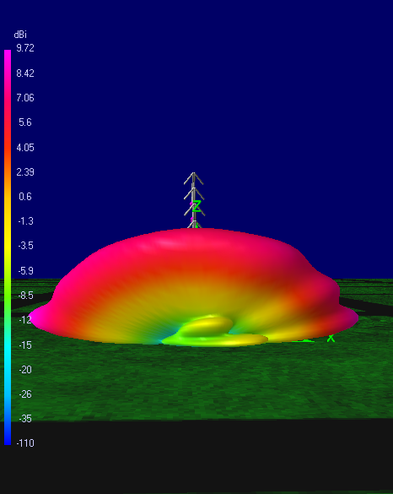
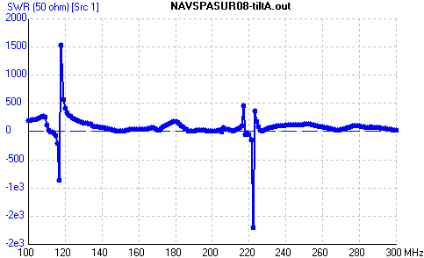
8/7 Dipole Array

